Slide 1


Retail Supply Chain &
Sales Analysis
B Y SHANU MUHAMMED OP

Slide 2


Content
Project Overview Architecture Diagram
Data Cleaning & Transformation Data Insights
Recommendation Power BI Dashboards

Slide 3



Project Overview
Objective :
This project aims to analyze Retail sales trends, customer behavior, and shipping performance to optimize pricing strategies, logistics operations, and customer retention through data-driven insights.
Dataset Details :
Source: Kaggle
Total Records: 9994-Rows 23-Columns
Key columns: Sales, Quantity, Discount, Profit ,Order Date, Ship Date, Ship Mode ,Customer Name, Segment ,Category, Product Name, Region, State, Returned

Slide 4

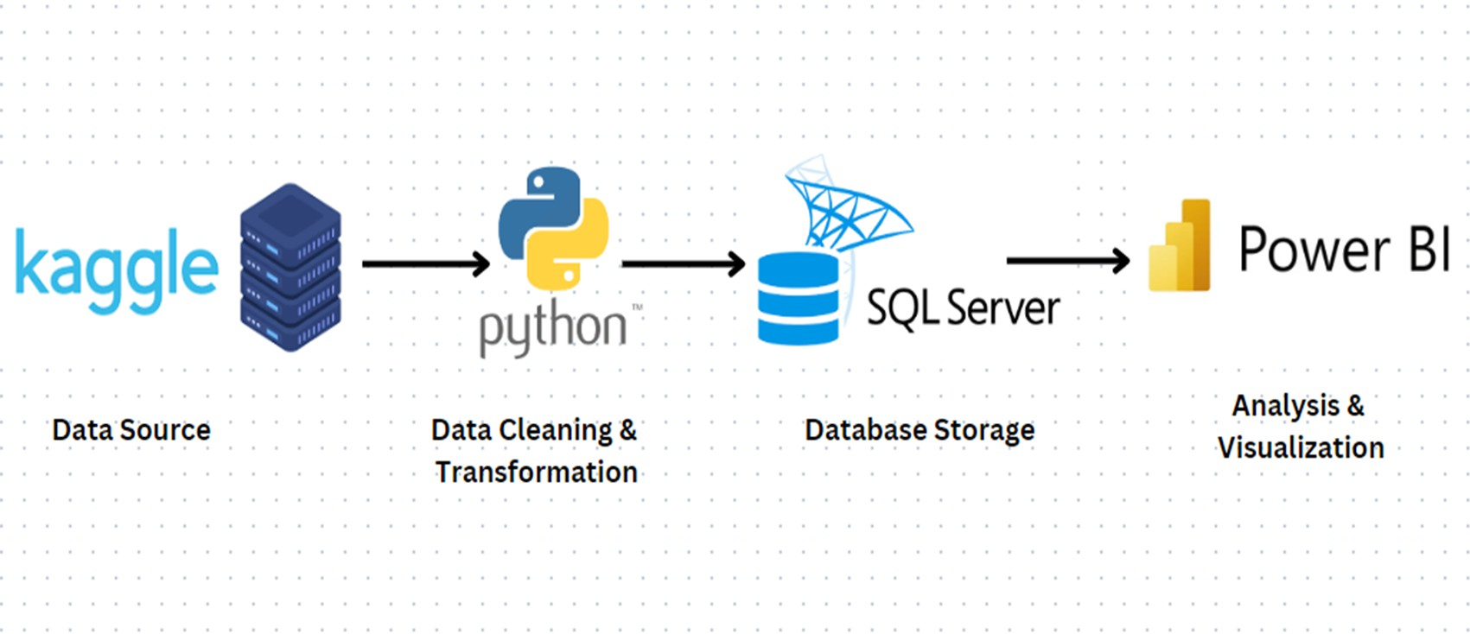

Architecture Diagram

Slide 5




Data Cleaning & Transformation
3) Revenue
PYTHON
Handling Null value : Ship_mode and category column Creating the new features: 1) Delivery time 2) Shipping status
POWER BI
Create Date Table = For time based analysis Data modeling- Date table and Retail sales table Created some measures using DAX for KPI’s
1) Total orders
3) On-time delivery rate
5) Return rate
2) Total Loss
4) Delayed delivery rate

Slide 6
Data Insights
Sales Performance: California, New York, and Texas contribute the highest sales, while November & December see peak demand.
Profit & Discounts: High discounts (above 30%) reduce profitability, and the Central region has the highest loss percentage (58.65%).
Shipping Performance: 68.35% of orders faced delays, with Standard Class having the longest delivery time (41.84 days).
Customer Behavior: 8% of total sales were returned, with Office Supplies having the highest return rate.

Slide 7
Recommendation
Optimize Regional Marketing: Focus on high-sales states like California and New York to maximize revenue.
Refine Discount Strategies: Reduce excessive discounts to improve overall profit margins.
Enhance Logistics & Shipping: Address high delivery delays by improving carrier efficiency and prioritizing faster shipping modes.
Improve Product Quality & Description: Minimize returns by ensuring better product quality and accurate descriptions for Office Supplies.

Slide 8
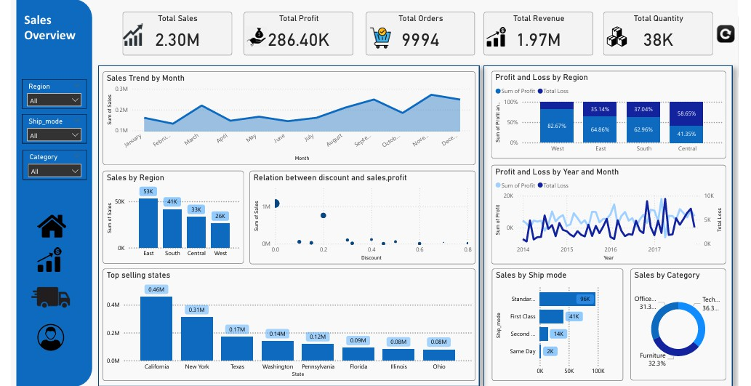
Power BI Dashboard

Slide 9
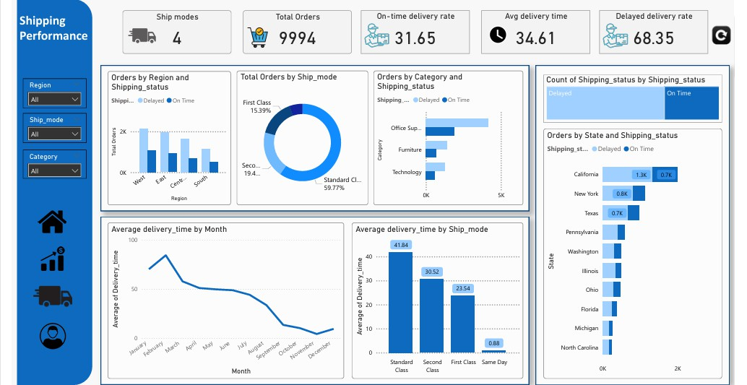
Power BI Dashboard

Slide 10
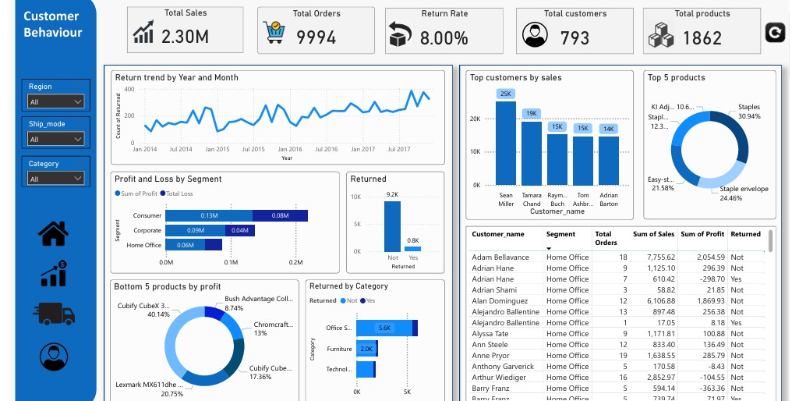
Power BI Dashboard

Slide 11


THANK YOU

